Slide 1


Preparing monosilane using trialkoxysilane
EP 2905258B1

Slide 2
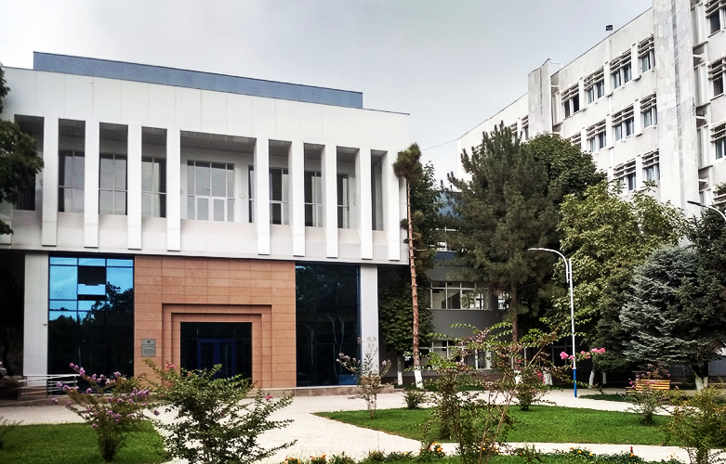
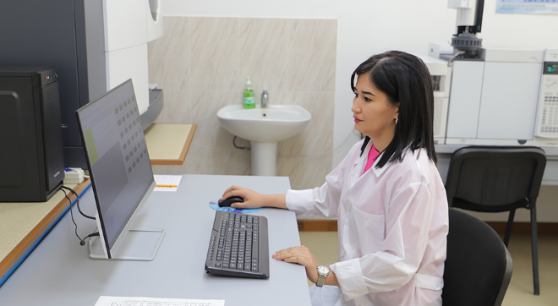
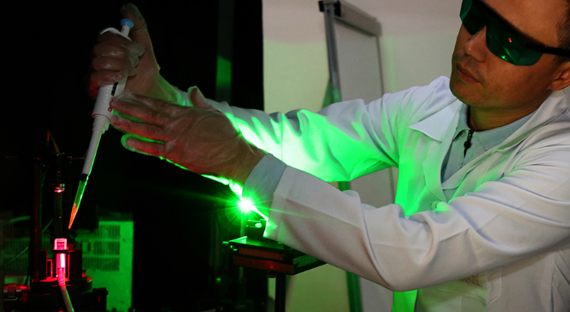
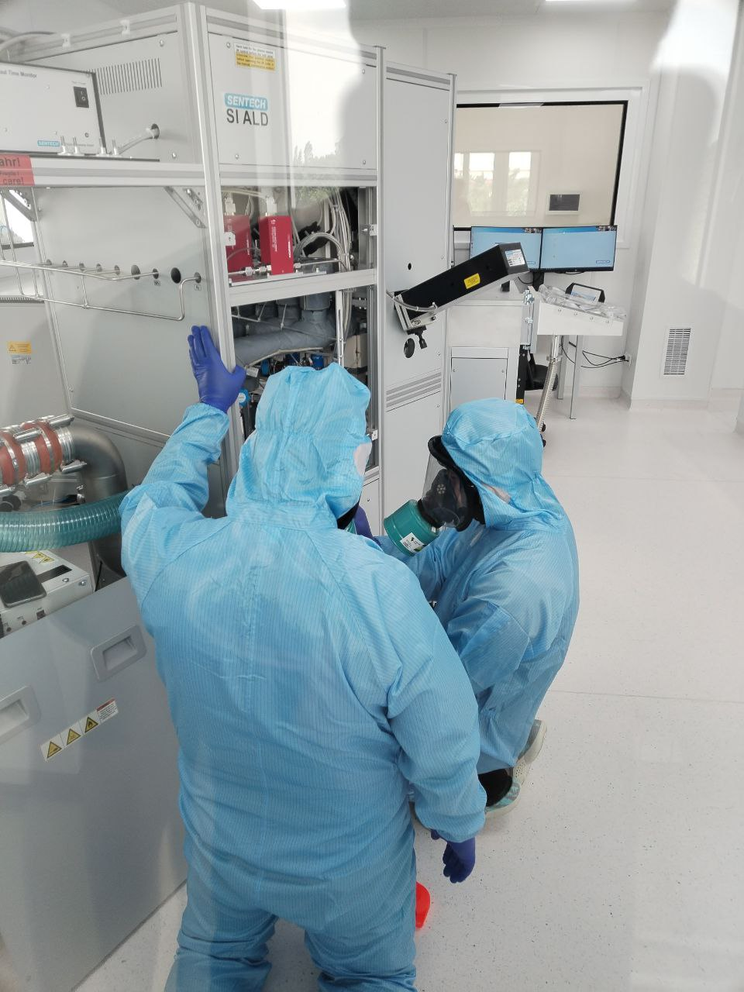
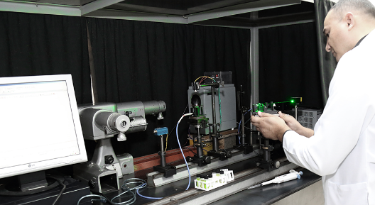
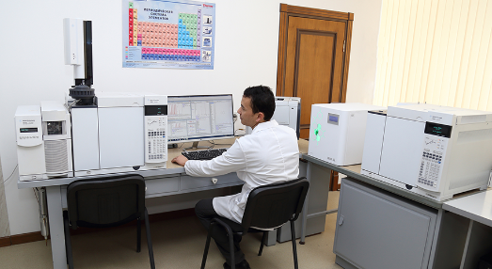
The Institute of Ion-Plasma and Laser Technologies is a leading center of excellence known for its comprehensive expertise in various fields including physical electronics, ion-plasma technologies, laser physics, optics, and molecular physics. Established as a premier scientific institution, it focuses on understanding the interaction of corpuscular flows, plasma, and laser radiation with solid surfaces. The Institute is dedicated to investigating nonlinear optical phenomena and the manipulation of material properties using charged particles and high-power laser radiation.
Our institute conducts research in line concentrating on the development of new materials, technologies, and devices. This includes creating ion-beam plasma, laser technologies for obtaining materials, including nanomaterials, and developing methods for producing various materials, modifying their properties, and devising innovative ion, plasma, and laser methods and devices.
Adsorption and emission phenomena, electronic and ion processes on surfaces.
Interaction of laser radiation with matter and nonlinear-optical processes.
Low-temperature plasma physics.
Molecular physics, heterogeneous media, nanostructures, and biomolecules.

Slide 3
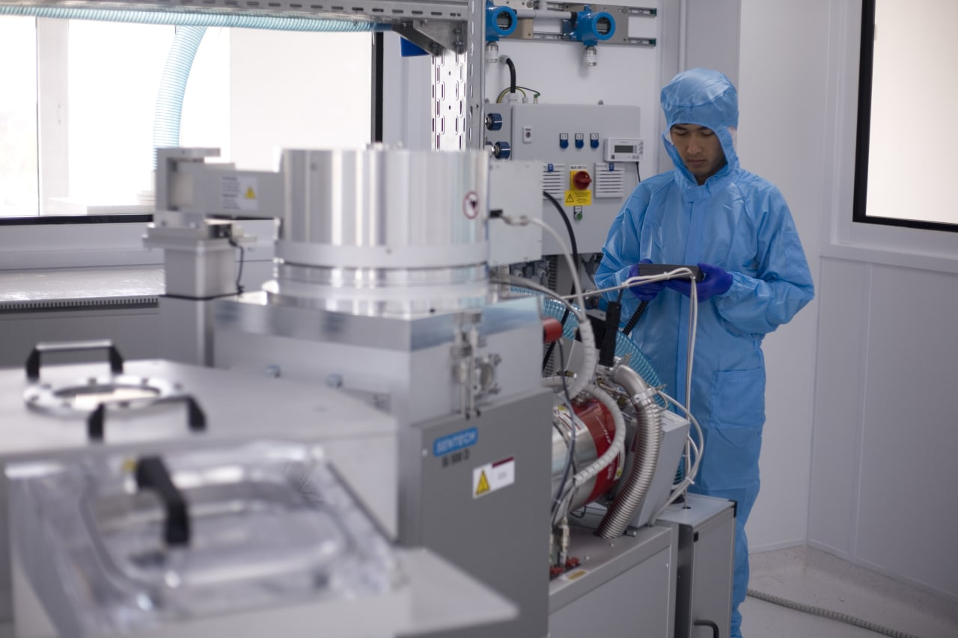
Laboratory of Applied Nanotechnologies
- Silicon based nanostructures
Carbon nanomaterial (synthesis, characterization, application)
- Thin film coatings (semi, PV, medical application)
- Energy storage (anode materials for ion-Li, Al-ion batteries)
- Membranes (ion-exchange)
Research personnel : 12 (including D.Sc. – 2, Ph.D. – 4)

Slide 4


The group primarily focuses on the development of new technologies for obtaining high-purity materials. The group has experience working with international partners, including South Korean companies. We collaborated with the South Korean company OCI on the development of a new chlorine-free technology for producing monosilane used in the growth of silicon polycrystals. The development was successful, and the technology was patented in multiple countries.
Patents obtained as a result of cooperation with a Korean company OCI:
Examples of successful transfer of intellectual property rights
KR101422080(B1), Pub. Date: July 22, 2014
KR101532142 (B1), Pub. Date: June 26, 2015
US 9156861 B2 Pub. Date: October. 13, 2015
JP5836489 (B2) Pub. Date: Dec. 24, 2015
JP6014771 (B2), Pub. Date: October 25, 2016
US9278864 (B2) Pub. Date: March. 8, 2016
TW I535657B Pub. Date: 01.06.2016
TW I549910 B Pub. Date: 21.09.2016
EP2905258B1 Pub. Date: 30.10.2022
UZ Patent IAP 07435, 28.07.2023
1994- Technology of electrical discharge processing of metals
Transfer
1996- Vacuum arc surface treatment
Transfer

Slide 5
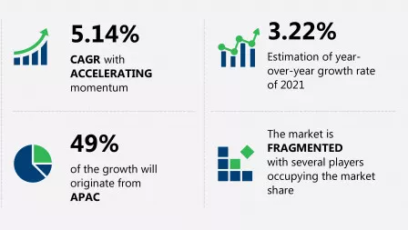


Market Dynamics of Monosilane and Silane
The Monosilane and Silane Market valued at $47 Billion in 2024, is expected to reach $82.67 Billion by 2031, growing at a robust CAGR of 8.4% from 2024 to 2031, highlighting significant market expansion over the forecast period
source: technavio
Monosilane and silane are essential in the production of semiconductors, particularly in the deposition of silicon layers. The growth of the electronics industry, including consumer electronics, automotive electronics, and the expansion of 5G networks, drives demand.
Aslo photovoltaic industry, which produces solar panels, is a significant consumer of monosilane. The increasing adoption of renewable energy sources globally supports demand growth.

Slide 6
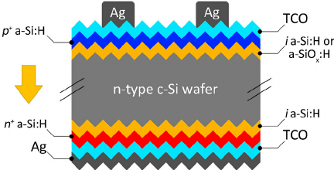
HIT solar cells
Monosilane (SiH₄) plays a critical role in the production of Heterojunction with Intrinsic Thin layer (HIT) solar cells due to its unique properties and essential functions in the manufacturing process. Here’s why monosilane is so important in HIT solar cell production:
Cell record efficiency: 26,81%
LONGi 2022
on full-size silicon wafers
Panel record efficiency: 23,89%
Risen Energy 2023 741,5 W
Lin, H., Yang, M., Ru, X. et al. Silicon heterojunction solar cells with up to 26.81% efficiency achieved by electrically optimized nanocrystalline-silicon hole contact layers. Nat Energy 8, 789–799 (2023). https://doi.org/10.1038/s41560-023-01255-2

Slide 7
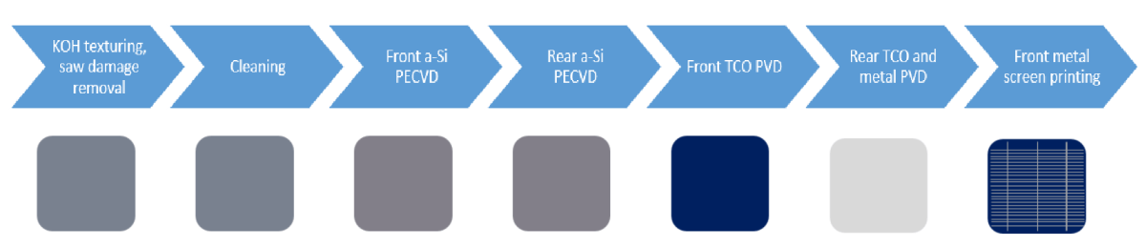
HIT solar cells
Intrinsic and Doped Layers: HIT solar cells consist of a crystalline silicon wafer sandwiched between thin layers of intrinsic (undoped) and doped amorphous silicon. Monosilane is the primary gas used in the plasma-enhanced chemical vapor deposition (PECVD) process to deposit these thin amorphous silicon layers.
High-Purity Deposition: Monosilane enables the deposition of high-purity, defect-free amorphous silicon, which is crucial for achieving the desired electrical properties and overall efficiency of the HIT solar cells.
SiH₄
SiH₄
Source: PV-Manufacturing.org
The intrinsic layer of amorphous silicon is deposited from silane (SiH₄) with a large proportion of hydrogen (H₂) for hydronization

Slide 8
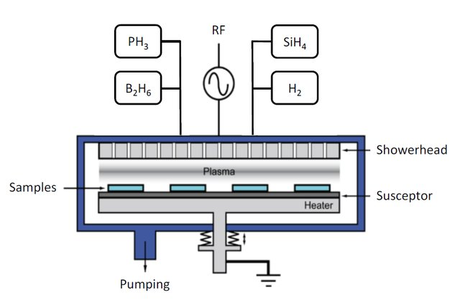
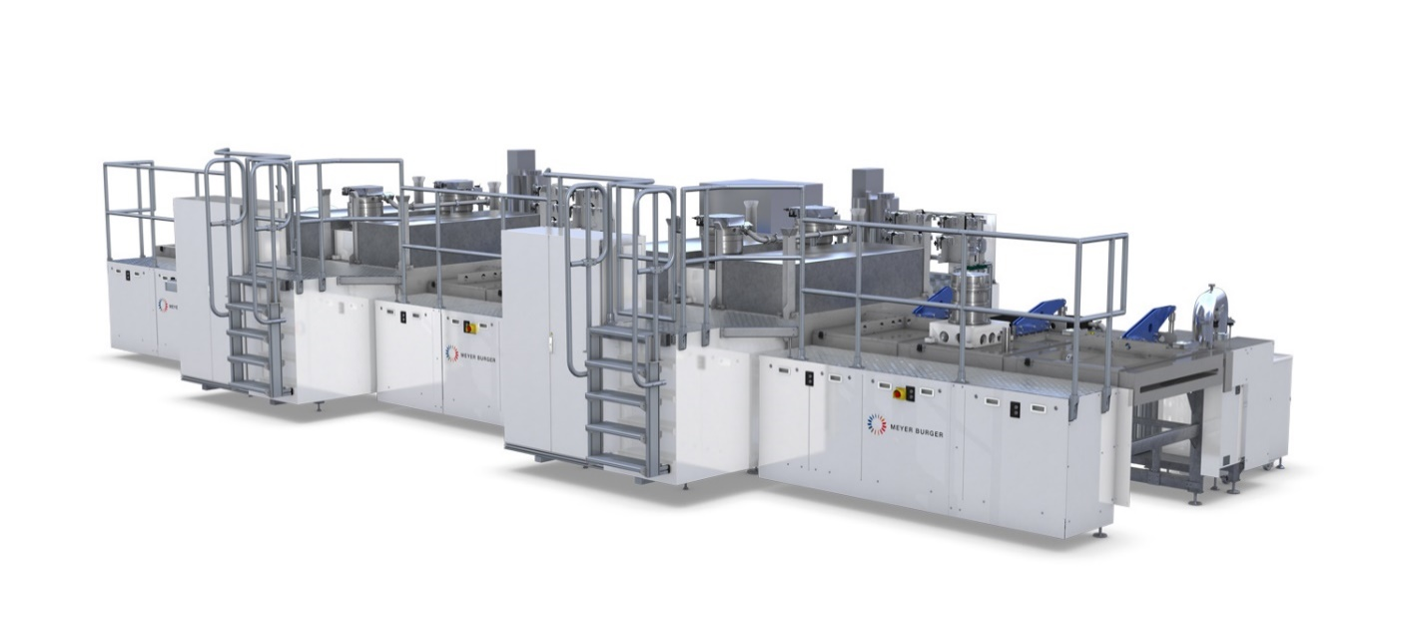
HIT solar cells
The HIT technology benefits from the low-temperature deposition processes enabled by monosilane. This is crucial because it prevents damage to the crystalline silicon substrate and maintains its high-quality crystalline structure, which is essential for achieving high efficiency.
Scalability: The use of monosilane in PECVD processes is scalable, making it feasible for both small-scale and large-scale production of HIT solar cells.
Industrial Coating System Meyer Burger Helia
Schematic of a PECVD chamber for a-Si:H layer deposition
PECVD using monosilane allows for precise control over the thickness and uniformity of the deposited layers, which is critical for consistent cell performance.

Slide 9
The Global Polysilicon Market Size Was Valued At USD 8.87 Billion In 2022 And Is Projected To Reach USD 27.07 Billion By 2030 at a CAGR Of 13.2% From 2023 To 2030 (Source: Contrive Datum Insights Pvt Ltd) of which the output by using Siemens process (trichlorosilane process) accounts for more than 90%

Slide 10
New monosilane production process
Triethoxysilane (TES) synthesis
Si + 3C₂H₅OH → SiH(OC₂H₅)₃ + H₂
2. Monosilane (MS) synthesis:
4SiH(OC₂H₅)₃ → SiH₄ + 3Si(OC₂H₅)₄
3. Polysilicon production:
SiH₄ → Si + 2H₂

Slide 11
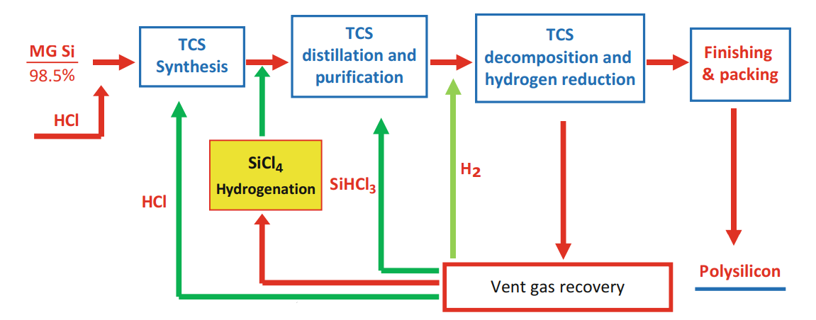
Siemens TCS
Catalysts
MG Si (98.9%)
TES
Synthesis
TES
purification
MS synthesis
MS purification
And collection
Pure H2 gase
Ethanol (99%)
TEOS
IPLT TES
Ethanol recovery
Polysilicon

Slide 12
Energy consumption and waste emission
 | IPLT TES | Siemens TCS
Electricity consumption (kW/1kg SG Si) | 32-50 | 41-115
Water consumption (m3/1kg SG Si) | 1.7-4 | 3-8
CO2 emission (kg/1kg SG Si) | 17-45 | 29-85
Quartzite Silicone ore (kg/1kg SG Si) | 4.25 | 4.1

Slide 13
Price structure
Prospect of reduction
Taxes
Reducing the wastes
Infrastructure support
Scaling up
Labor cost
Energy cost
Raw material
(MG Si, Ethanol, Cu, ect)
Increasing the selectivity

Slide 14
Benefits for SMEs
Reduction of CAPEX: Using our technology significantly reduces capital expenditures on the construction and launch of production facilities, thanks to the modular type of production organization. This makes investment in the project more accessible for small and medium-sized enterprises.
Increased Competitiveness: Due to economic efficiency in small-scale production, small and medium-sized enterprises can successfully compete with large manufacturers in local and regional markets.
Integration into Production Chains: The technology easily integrates into existing production lines for HIT solar cells, where monosilane is required as a raw material. This opens a new chapter in the development of solar energy, making it possible to produce solar panels within the framework of small and medium-sized businesses.
Reducing Dependency on Imports: European manufacturers do not need to rely on imported silane, particularly from China, if there are small-scale production facilities nearby that can meet their needs. This reduces the risks associated with external market factors such as currency exchange rate fluctuations and customs duties. The ability to integrate monosilane production with solar panel manufacturing and to develop such production complexes within the framework of small and medium-sized businesses opens up the possibility for the European market to achieve independence from Chinese and other external monopolists in the solar panel production
sector.
Stimulating Local Development: The creation of small and medium-sized production enterprises in this area contributes to the development of the local economy, job creation, and the growth of the industrial base in the region.
Overall, the use of this technology allows small and medium-sized enterprises to enter the silane and silicon market, previously accessible only to large players, and ensure economic efficiency in production under limited volume conditions.

Slide 15
Wastes
Solid | Liquid | Gases
 | Ethanol | Hydrogen
Si particles < 3 mcm | T-66 oil | TEOS an TES gases
Filter wastes
Impurites
Cu particles
By product
TEOS
Recyclable
Non-recyclable

Slide 16
Byproduct value
Tetraethyl orthosilicate (TEOS) is a chemical compound with the formula Si(OC2H5)4. It is primarily used as a precursor for the synthesis of silica-based materials and coatings. Some of the applications of TEOS include:
1. Sol-gel process: TEOS is commonly used in the sol-gel process, which involves the conversion of a liquid precursor into a solid material through a chemical reaction. TEOS is hydrolyzed in the presence of water to form silica gel, which can then be used to create thin films, coatings, and nanoparticles.
2. Optical coatings: TEOS is used in the production of anti-reflective coatings for optical lenses and glass surfaces. The sol-gel process allows for the deposition of a thin layer of silica onto the surface, reducing reflection and increasing light transmission.
3. Semiconductor industry: TEOS is utilized in the fabrication of microelectronics and integrated circuits. It is used as a precursor for the deposition of silicon dioxide (SiO2) layers, which act as insulating or dielectric materials.
4. Protective coatings: TEOS can be used to create protective coatings on various substrates. The sol-gel process enables the formation of a thin, transparent, and durable layer that provides resistance to corrosion, UV radiation, and chemical attack.
5. Catalysis: TEOS can be used as a catalyst or catalyst support in various chemical reactions. It can be incorporated into catalyst formulations to enhance their activity, selectivity, and stability.
6. Nanotechnology: TEOS is employed in the synthesis of silica nanoparticles, which have applications in drug delivery systems, sensors, electronics, and optoelectronics.
Overall, TEOS is a versatile compound that finds applications in various industries due to its ability to form silica-based materials with desirable properties such as transparency, hardness, and chemical resistance.
Sigma Aldrich prices

Slide 17
Technical Problem
To solve the problem of the induction period during the initial period of the reaction when alkoxysilane is prepared, the decrease in selectivity and conversion ratio of a final product, the problem of continuous reaction, the decrease in productivity and the like, an object of the present invention is to provide a new method for preparing monosilane, which simplifies and improves the preparation process while ensuring continuity, operability, productivity, and stability
Further, in order to remove the ad disadvantages described above, an object of our invention is to provide a method for preparing monosilane, which ensures rapid reduction or removal of the initial induction period of the synthesis reaction of alkoxysilane, simplification of the technology, improvement in reaction selectivity, and possibility of synthesis of monosilane through a continuous process.

Slide 18
Technical Solution
In order to solve the problems described above, our invention provides a method for preparing monosilane, which includes:
(a) performing wet pulverization of silicon particles in a liquid-phase solvent until the silicon particles have a size from 30 mm to 100 mm;
(b) continuously supplying a suspension, which includes pulverized silicon obtained in step (a) and the solvent, into a reactor, followed by synthesizing alkoxysilane of triethoxysilane and tetraethoxysilane through reaction of the pulverized silicon particles with anhydrous ethyl alcohol using a copper-based catalyst;
(c) synthesizing monosilane gas from the obtained triethoxysilane by performing a catalytic disproportionation process of the triethoxysilane using sodium ethoxide as a catalyst.

Slide 19
Advantageous Effects
When monosilane is prepared according to the technical solution described above using our invention, performance is excellent, and feasibility is sufficient under laboratory conditions as well as at industrial scale. In addition, there is an effect that the preparation process may be simplified and improved while ensuring continuity, operability, productivity, and stability of the preparation process.
Furthermore, as specific effects, there are improved effects as follows.
It is possible to decrease the initial induction period of the synthesis of alkoxysilane by approximately 15 times.
Process selectivity for triethoxysilane, which is a main product, is ensured at the 96% level.
A synthesis reaction of triethoxysilane and monosilane may be performed in a continuous process which maintains a high and stable synthesis rate.
The productivity of the preparation process is increased by decreasing the contact time of a reagent by 5 times or more.
The conversion ratio of triethoxysilane into monosilane is excellent.

Slide 20
Claims
A method for preparing monosilane, comprising:
performing wet pulverization of silicon particles in a liquid-phase solvent until the silicon particles have a particle size of 30 mm to 100 mm;
continuously supplying a suspension, which comprises the pulverized silicon particles obtained in step (a) and the solvent, into a reactor, followed by synthesizing alkoxysilane of triethoxysilane and tetraethoxysilane through reaction of the pulverized silicon particles with anhydrous ethyl alcohol using a copper-based catalyst; and
synthesizing monosilane gas from the for obtained triethoxysilane using sodium ethoxide as a catalyst.
Liquid-phase solvent used in step (a) is also used as a solvent for synthesis of monosilane in step (b).
In step (a), synthesis of alkoxysilane of triethoxysilane and tetraethoxysilane is performed in a solvent environment, which has been heated to 160°C to 300°C.
In step (a), the wet pulverization in a liquid-phase solvent environment is performed while mixing a copper-based catalyst with the silicon particles

Slide 21
Claims
The method according to claim, wherein, in step (b), the suspension, which comprises the pulverized silicon particles obtained in step (a) and the solvent, is continuously supplied into the reactor so as to be replenished in consideration of an amount of silicon consumed in synthesis reaction of alkoxysilane, and the amount of silicon consumed in the synthesis reaction is calculated from an amount of synthesized alkoxysilane according to Equation:
mSi=k1 mTes + k2 mTEOS
where mSi is a mass of silicon consumed as a result of direct reaction for unit time, mTES is a mass of triethoxysilane prepared as a result of direct reaction for unit time, mTEOS is a mass of tetraethoxysilane prepared as a result of EP 2 905 258 A1 direct reaction for unit time, coefficient k1 is a molecular weight ratio of silicon to triethoxysilane [molecular weight of silicon/molecular weight of triethoxysilane], and coefficient k2 is a molecular weight ratio of silicon to tetraethoxysilane [molecular weight of silicon/molecular weight of tetraethoxysilane].
Feeding the suspension and Removing the impurities
1
2
3
in step (b), a weight ratio of the solvent to silicon in the suspension continuously supplied into the reactor ranges from 1:2 to 2:1.
The suspension is continuously discharged from the reactor in the same amount as the suspension supplied into the reactor.
Impurities are removed by continuously discharging the suspension from the reactor using a ceramic membrane mounted in a main body of the reactor.
The ceramic membrane has a pore size in the range of 1 mm to 10 mm

Slide 22
The method:
continuously removing unreacted anhydrous ethyl alcohol and an azeotropic mixture of anhydrous ethyl alcohol and triethoxysilane from the reactor at atmospheric pressure during a condensation process performed for separation of triethoxysilane of step
purifying triethoxysilane
purifying monosilane by adsorbing impurities in monosilane at a temperature from -150°C to -140°C using triethoxysilane.
sodium ethoxide prepared immediately before a disproportionation process at a temperature of 0°C to 50°C is used as the catalyst
sodium metal and anhydrous ethyl alcohol, the anhydrous ethyl alcohol is reacted 2 times to 5 times more in an amount than the stoichiometric amount.
sodium ethoxide is directly prepared through reaction of the sodium metal and the anhydrous ethyl alcohol, tetraethoxysilane is added to a solution of the sodium ethoxide produced in the anhydrous ethyl alcohol environment.
sodium ethoxide is directly prepared through reaction of the sodium metal and the anhydrous ethyl alcohol, tetraethoxysilane is added to a solution of the sodium ethoxide produced in the anhydrous ethyl alcohol environment.

Slide 23

Company: “Yulduz Enviroment” Closed Joint Stock Company
Email: info@eyulduz.com
Site: eyulduz.com
The Laboratory of Applied Nanotechnologies of the Institute of Ion-Plasma and Laser Technologies named after U. Arifov of the Academy of Sciences of the Republic of Uzbekistan.

